Slide 1

Employment in the Data Science Field
Matthew, Austin, Luis, and Joy

Slide 2


Project Overview:
Our project seeks to examine employment trends within the data science field. Through a thorough analysis of the "Jobs in Data" dataset sourced from Kaggle, we aim to gain insights into the prevailing patterns and dynamics of employment in this growing industry.

Slide 3
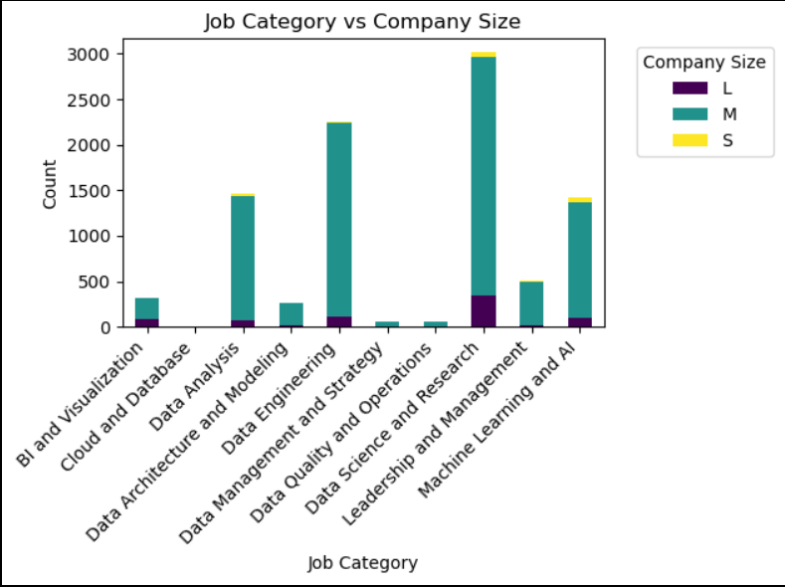
What is the most popular job field in data and how does it compare to the size of the company?
We see data science and research is the most popular field for a mid sized company
A company size is defined by:
Company Size: S = less than 50 employees (small) M = 50 to 250 employees (medium) L = more than 250 employees (large)

Slide 4

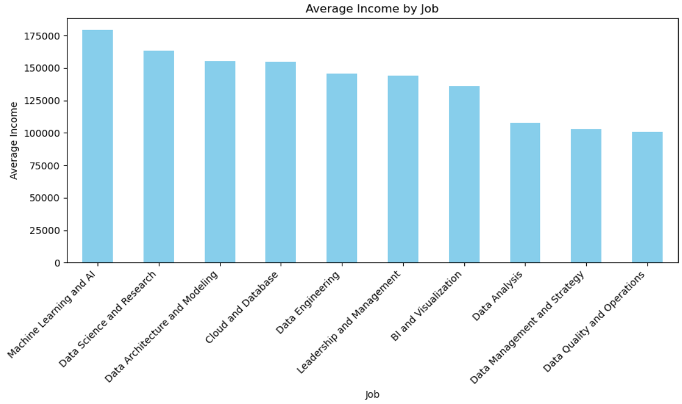
Machine learning and AI returns the Highest average by (USD) in the field
Highest paying job: Research Scientist with a salary of 450000 USD Employee Residence: United States
*follow link to show data
http://127.0.0.1:5000/api/v1.0/jobs-data

Slide 5
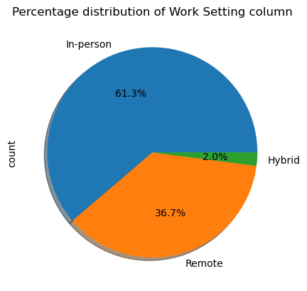
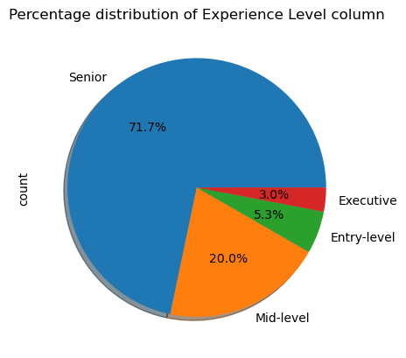
Work setting and experience
.

Slide 6
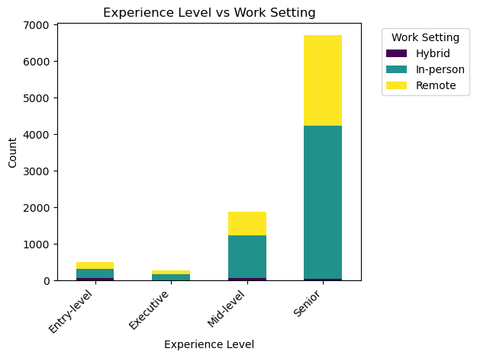
Experience vs work setting
Distribution
Majority of jobs across all experience levels require employees be in-person.
Approximately a third of positions are available as remote.
Only a tiny fraction of jobs are considered hybrid.

Slide 7
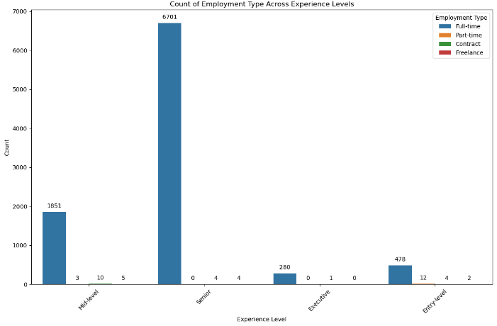

Slide 8
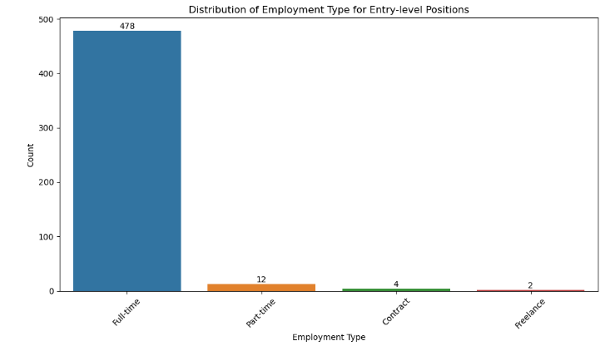
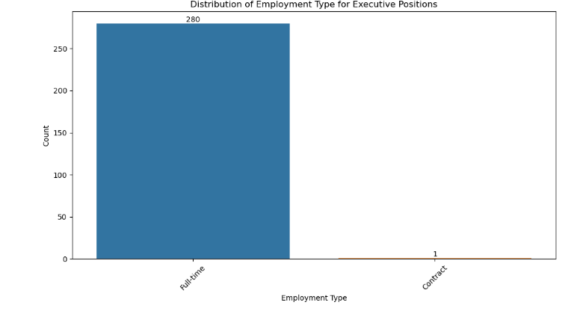
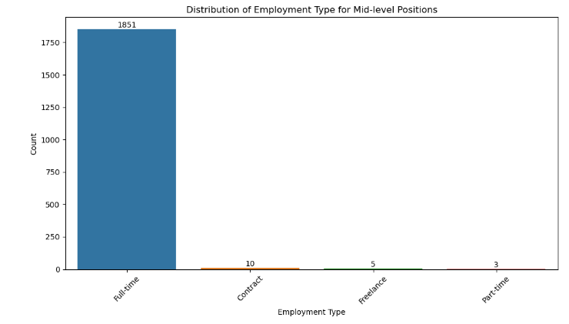
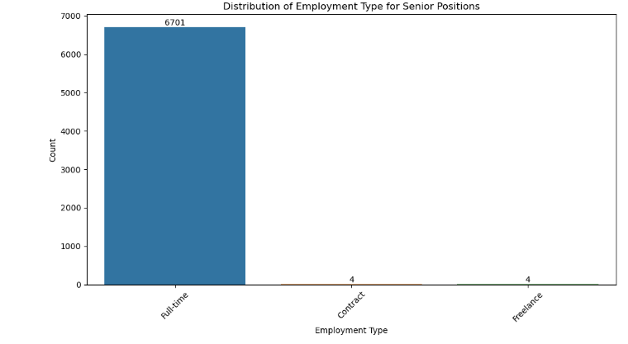

Slide 9
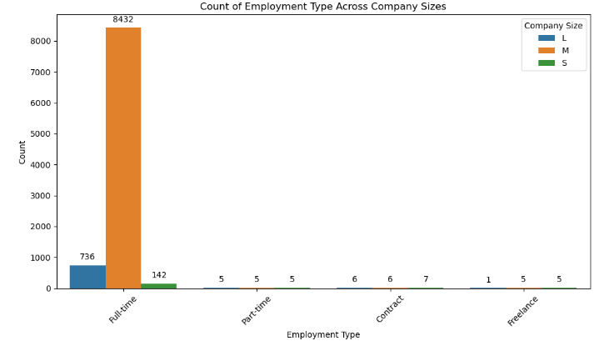

Slide 10
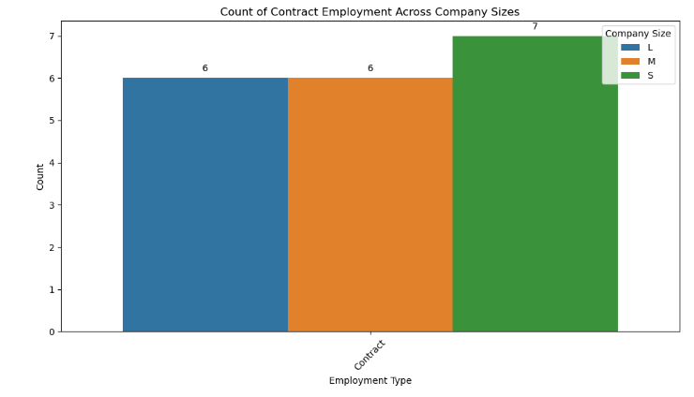
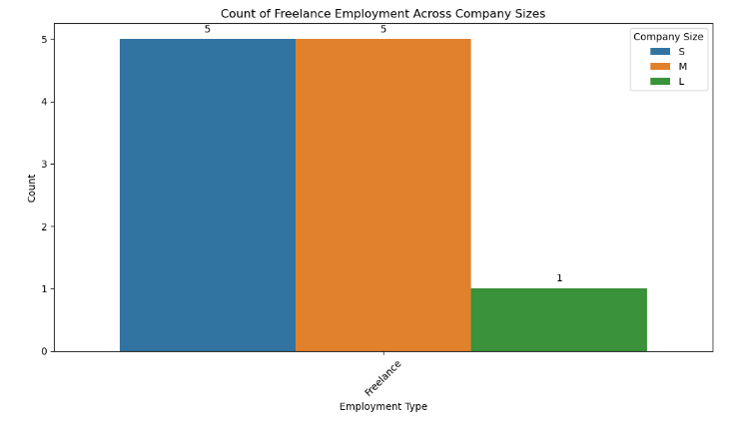
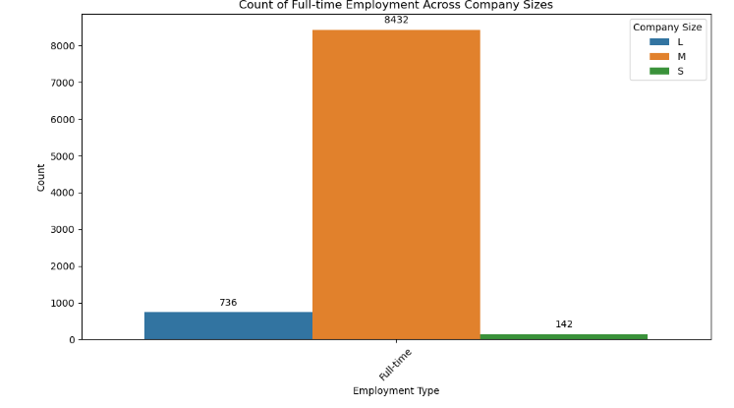
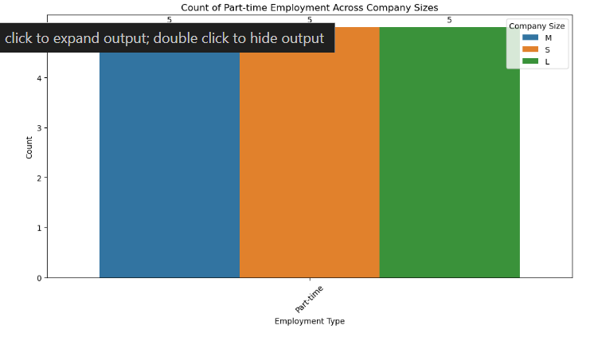

Slide 11
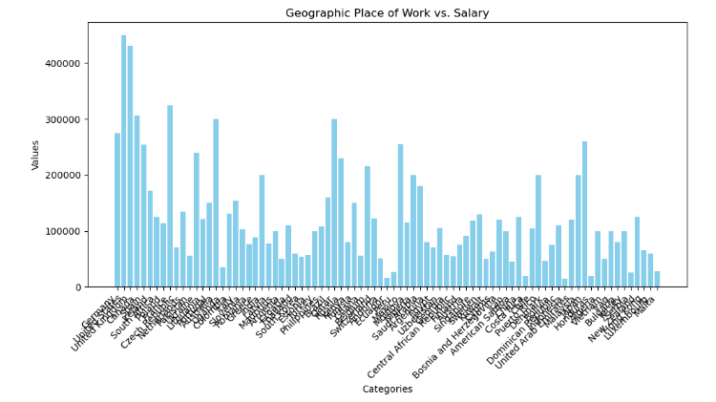

Slide 12
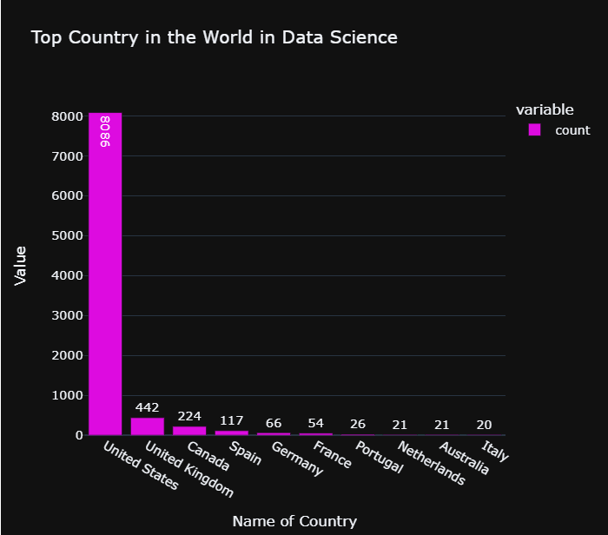
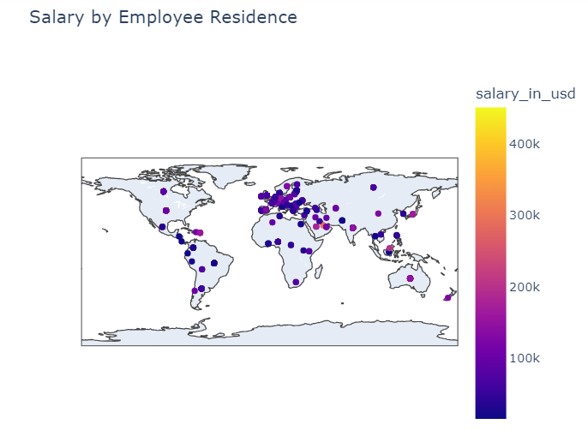

Slide 13




Summary
In our project, ethics play a central role. We handle the data from the "Jobs in Data" dataset on Kaggle with care, ensuring responsible use throughout. While personal information isn't part of our analysis, we prioritize privacy and confidentiality. We also strive for fairness in our approach, considering different aspects of employment trends in the data science field. When sharing our insights, we do so respectfully, mindful of the impact on all parties involved. Our aim is to conduct research that upholds ethical standards and contributes positively to understanding employment dynamics in data science.

Slide 14

Thank you

